Slide 1

Analysis of IBM Employment Factors that Influence Attrition
Team 38
Jack Lusk
Sasakorn Phanitsombat

Slide 2
Objective/Problem
• Employee attrition is a significant challenge faced by organizations today
• High turnover rates impact productivity, team dynamics, and incur substantial costs
• The project aims to leverage IBM's employee data to build a predictive model for identifying influential factors and improving employee retention strategies

Slide 3
Primary Research Question (RQ)
• What are the influential indicator variables that contribute to employee attrition based on IBM's employee data?
Supporting Research Questions:
1. Relationship between job satisfaction and attrition
2. Impact of years at the company on attrition
3. Correlation between performance ratings and attrition
4. Role of salary or annual raise in attrition

Slide 4
Business Justification
• High employee attrition rates lead to productivity losses and significant costs
• This analysis will provide insights to develop effective retention strategies
• Quantifiable benefits include cost savings in hiring, training, and onboarding

Slide 5
Dataset/ Plan for Data
• Data Source: IBM HR Analytics Employee Attrition & Performance dataset from Kaggle
• 1470 rows of employee data
• Key Variables: Job satisfaction, years at the company, performance rating, salary, percent raise, and demographic information

Slide 6
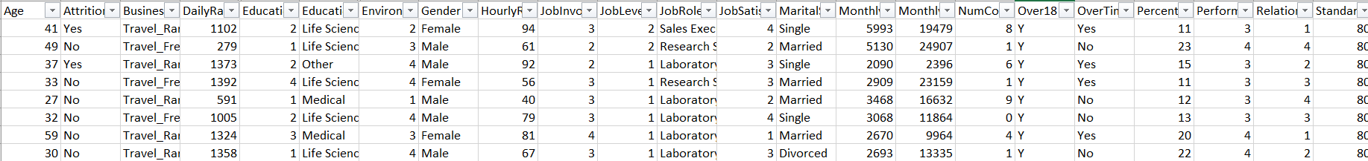
Dataset
• Data Source: IBM HR Analytics Employee Attrition & Performance dataset from Kaggle
• 1470 rows of employee data and 32 indicator variables

Slide 7
Indicator and response variables
The dataset includes the following indicator variables:
Job satisfaction: Job satisfaction rating out of 5
Years at the company: Number of years the employee has been with the company
Performance rating: Performance rating out of 5
Salary: Monthly salary
Percent raise: Salary raise from last year’s salary
Several demographic information such as age, gender, and education level
The response variable is attrition

Slide 8
Data collection and preprocessing
The dataset was verified to have no blanks or N/As
Certain indicator variables were changed to factors
The response variable, attrition, was changed to 0 or 1 for the logit regression
4 variables were removed

Slide 9
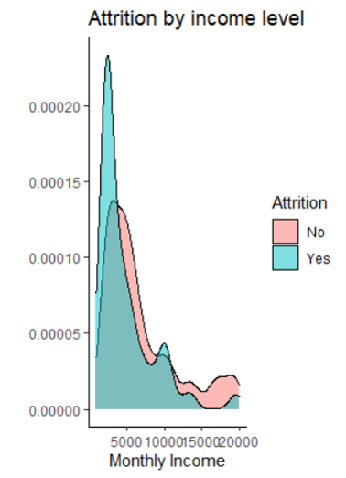

Exploratory data analysis – Income level
Attrition is much higher at lower monthly income
The levels are the highest where monthly income is less than $5000.

Slide 10
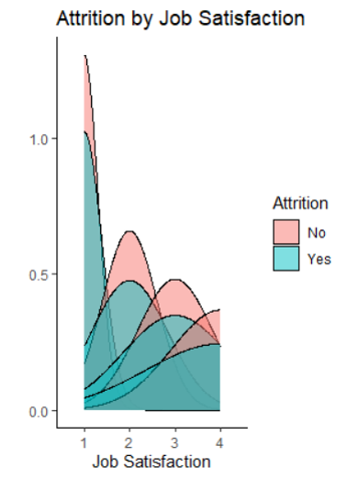

Exploratory data analysis – Job satisfaction and overtime
Attrition is much higher at lower job satisfaction.
Out of the employees that stayed 23.4% worked overtime and out of the employees that left 53.6% employees worked overtime.

Slide 11

Approach/Methodology
1. Logistic Regression Model: Changed response variable to 0 or 1 and ran glm package for binomial logistic regression model
Supervised Machine Learning:
Data split into training and test dataset at 80%/20% split
2. Support Vector Machine: Create vectors to separate employees that left and stayed
3. Decision Tree: Used rpart package and training dataset. Grouped employees based on shared attributes using clustering algorithms. Finding key variables at nodes and branches.

Slide 12
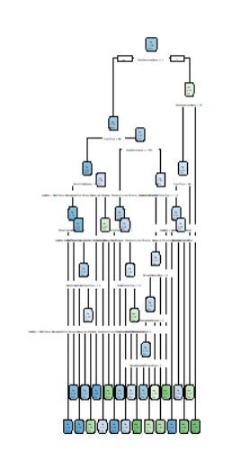

Decision tree
Main branches at:
TotalWorkingYears >= 1.5
OverTime= "No“
JobSatisfaction >=2
Model accuracy at 78.9% with the caret package

Slide 13

Support Vector machine and logistic regression
Support Vector Machine
E1071 r package with C-classification type SVM.
Model accuracy is 84.0%
Logistic Regression Model:
Significant variables: OverTime, DistanceFromHome, EnvironmentSatisfaction, JobInvolvement, JobSatisfaction, NumCompaniesWorked, WorkLifeBalance
Not statistically significant variables: PercentSalaryHike, TrainingTimesLastYear, YearsAtCompany, JobLevel, HourlyRate
AIC is 813.47

Slide 14

Conclusion
We found the following indicator variables were large factors for attrition: Overtime, JobSatisfaction, WorkLifeBalance, NumCompaniesWorked, MonthlySalary
Percent salary hike, years at company, education were not statistically significant factors
The decision tree was the best performing model and gave insight into indicator variables that were the most significant
Overtime and work life balance are significant factors with actionable methods of improving

Slide 15

recommendation
We advise management to enact a policy that limits overtime. Workers that had a poor work life balance and worked overtime were much more likely to leave the company
Job satisfaction and job involvement could be improved with employee enrichment programs such as skip level lunches, resource groups, and morale events.
Salary rate increase, job level and training last year were not significant. If salary rate increase does not align with performance rating, high performing employees can be discouraged. Extra training is not a large contributor towards attrition.

